Slide 1
FUNCTIONS OF MANAGEMENT
BUSINESS STUDIES XII
Prepared By- URVASHI KANWASI

Slide 2
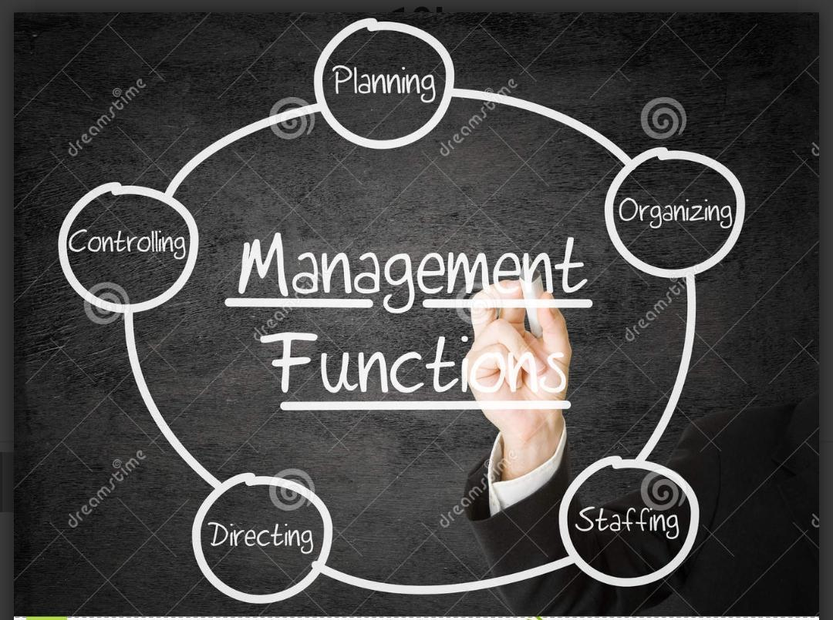

Slide 3
PLANNING
Planning is always the first function performed by every manager.
It refers to “deciding in advance what to do,how to do,when to do and who is going to do it.
Planning bridges gap between where we stand today and where we want to reach.
Planning is the base of all other functions of management.

Slide 4
ORGANISING
Recognising the resources required.
Finding out the activities required to be performed.
Assigning these activities to different employees according to their capabilities.
Establishing Authority and Responsibilty relationships among employees.Giving authority to capable person.

Slide 5
STAFFING
Putting right person at the right job is the keyword.
It is considered with the manpower requirement of the organisation.
This is also known as Human Resource Function & it involves activities such as RECRUITMENT,SELECTION,TRAINING PERSONNEL,PLACEMENT.

Slide 6
DIRECTING
Work begins with directing & it is known as “Management in action”.
Directing refers to employeees by motivating them,supervising the activities of employees, communicating with them.
Directing function includes SUPERVISING,MOTIVATING,COMMUNICATING & LEADERSHIP.

Slide 7
CONTROLLING
Comparison of actual performance with the planned performance.
The task of controlling involves establishing standards of performance, measuring current performance, comparing this with established standards & taking corrective action where any deviation is found.

Slide 8
F.A. Q’s -

Slide 9
Q1.Which function is considered as the base of all other functions?
Q2.Name the concept related to searching for prospective candidates?
Q3.Which function is known as “Management in Action”?
Q4.Which function ensures work accomplishment according to plans?

